Slide 1
Design Patterns: Composite
Content:
1. Problem
2. Solution
3. Benefits and Downsides

Slide 2
1.Problem
Let's say you work for an e-commerce site, there are two kinds of products:
Product — Typical individual object (toothpaste, apple, etc...)
Box — Group of products or even other boxes

Slide 3
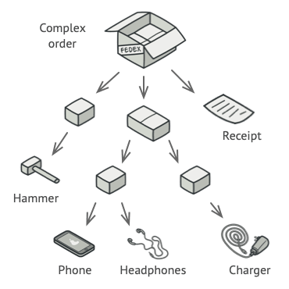
1.Problem
Visually speaking it would look more like this:
Calculate the price of an order?
One way would be to simply loop and check if the object is a Box or a Product. Nesting loop?

Slide 4
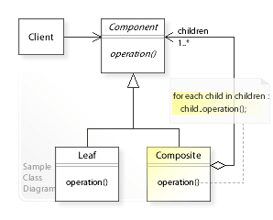
2. Solution
Formally speaking the composite pattern allows us to treat composites and individual objects equally.
It is based on Recursion principle.

Slide 5
2. Solution
Before we transform our code above, let us quickly go over the components of the composite pattern.
Component — The uniform interface that both the composite and the leaf will abide by.
Composite — Our "group" object that implements the component interface, and has a list of leaf objects.
Leaf — Our individual object, that directly implements the component interface.

Slide 6
2. Solution
Product — simple getPrice
Box — Loop through the children and call getPrice(if product it will simply return else repeat recursively)

Slide 7
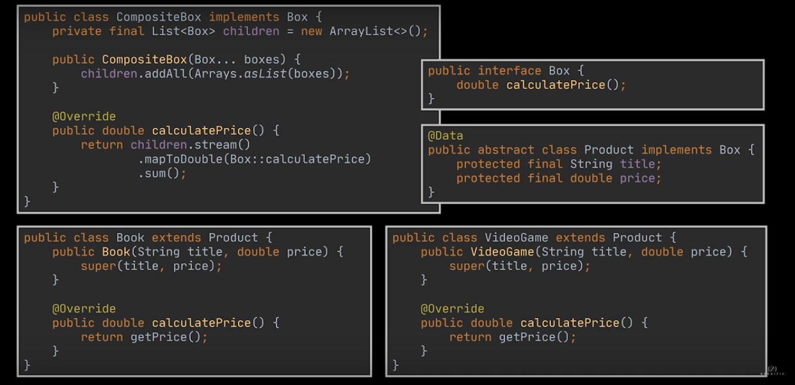
2. Solution

Slide 8
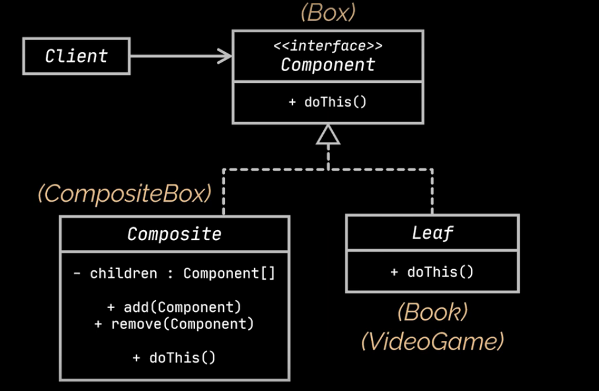
2. Solution

Slide 9
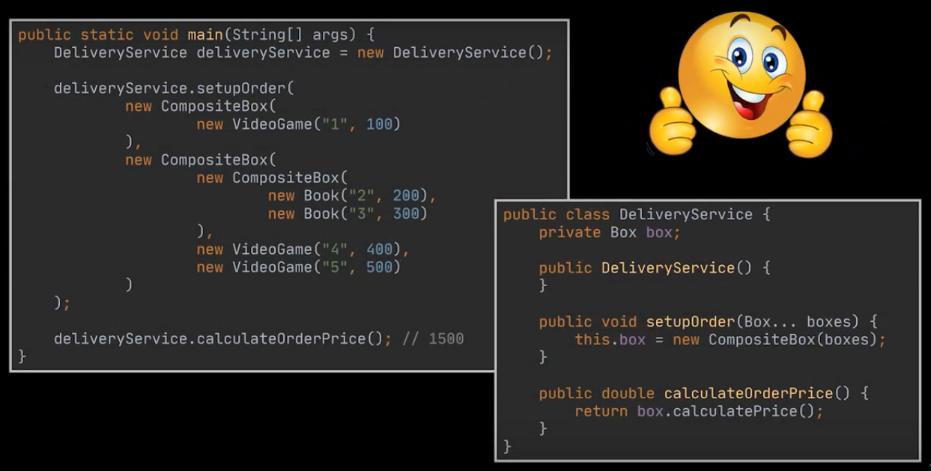
2. Solution

Slide 10
3. Benefits and Downsides
Benefits:
You can introduce new element types without
breaking existing code.
Now comes the downside:
Trees and Recursions are complex to implement, and therefore, error prone.

